Slide 1
ENSE 471, Milestone 2
Codebreakers
Ali Rizvi, Evan Geissler, Shayan Khan
03/13/2019

Slide 2
Introductions
Ali Rizvi
Future Undergrad Students/Grad Students
Evan Geissler
Faculty/Staff
Shayan Khan
Current Undergrad Students/Grad Students

Slide 3
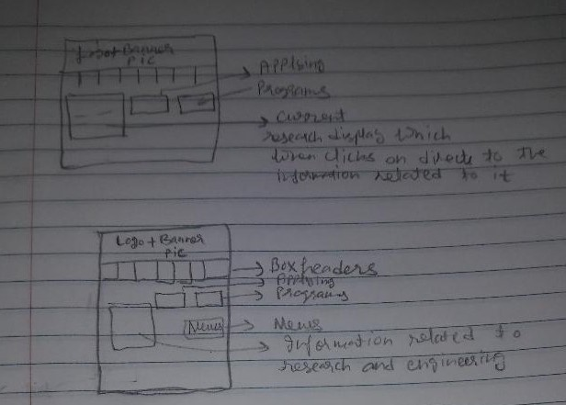
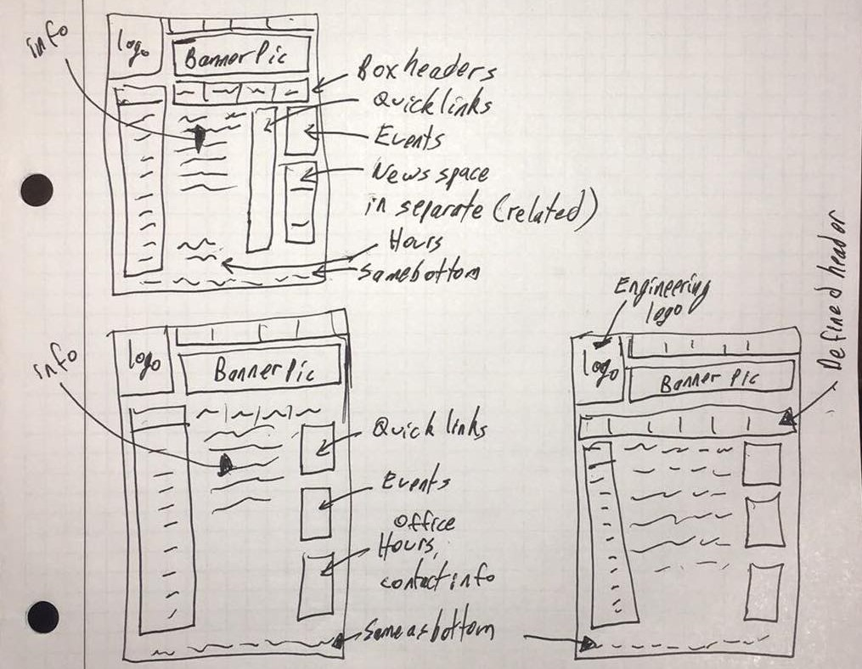
Brainstorm #1
We came up with a total of 15 ideations, 5 per group member/target customer
Some Ideations:

Slide 4
Evaluation
Received mixed response towards our designs :(
Desired more white space and larger banner buttons for the target customers (specifically for students)
Make better use of the back button and new tab functionality

Slide 5
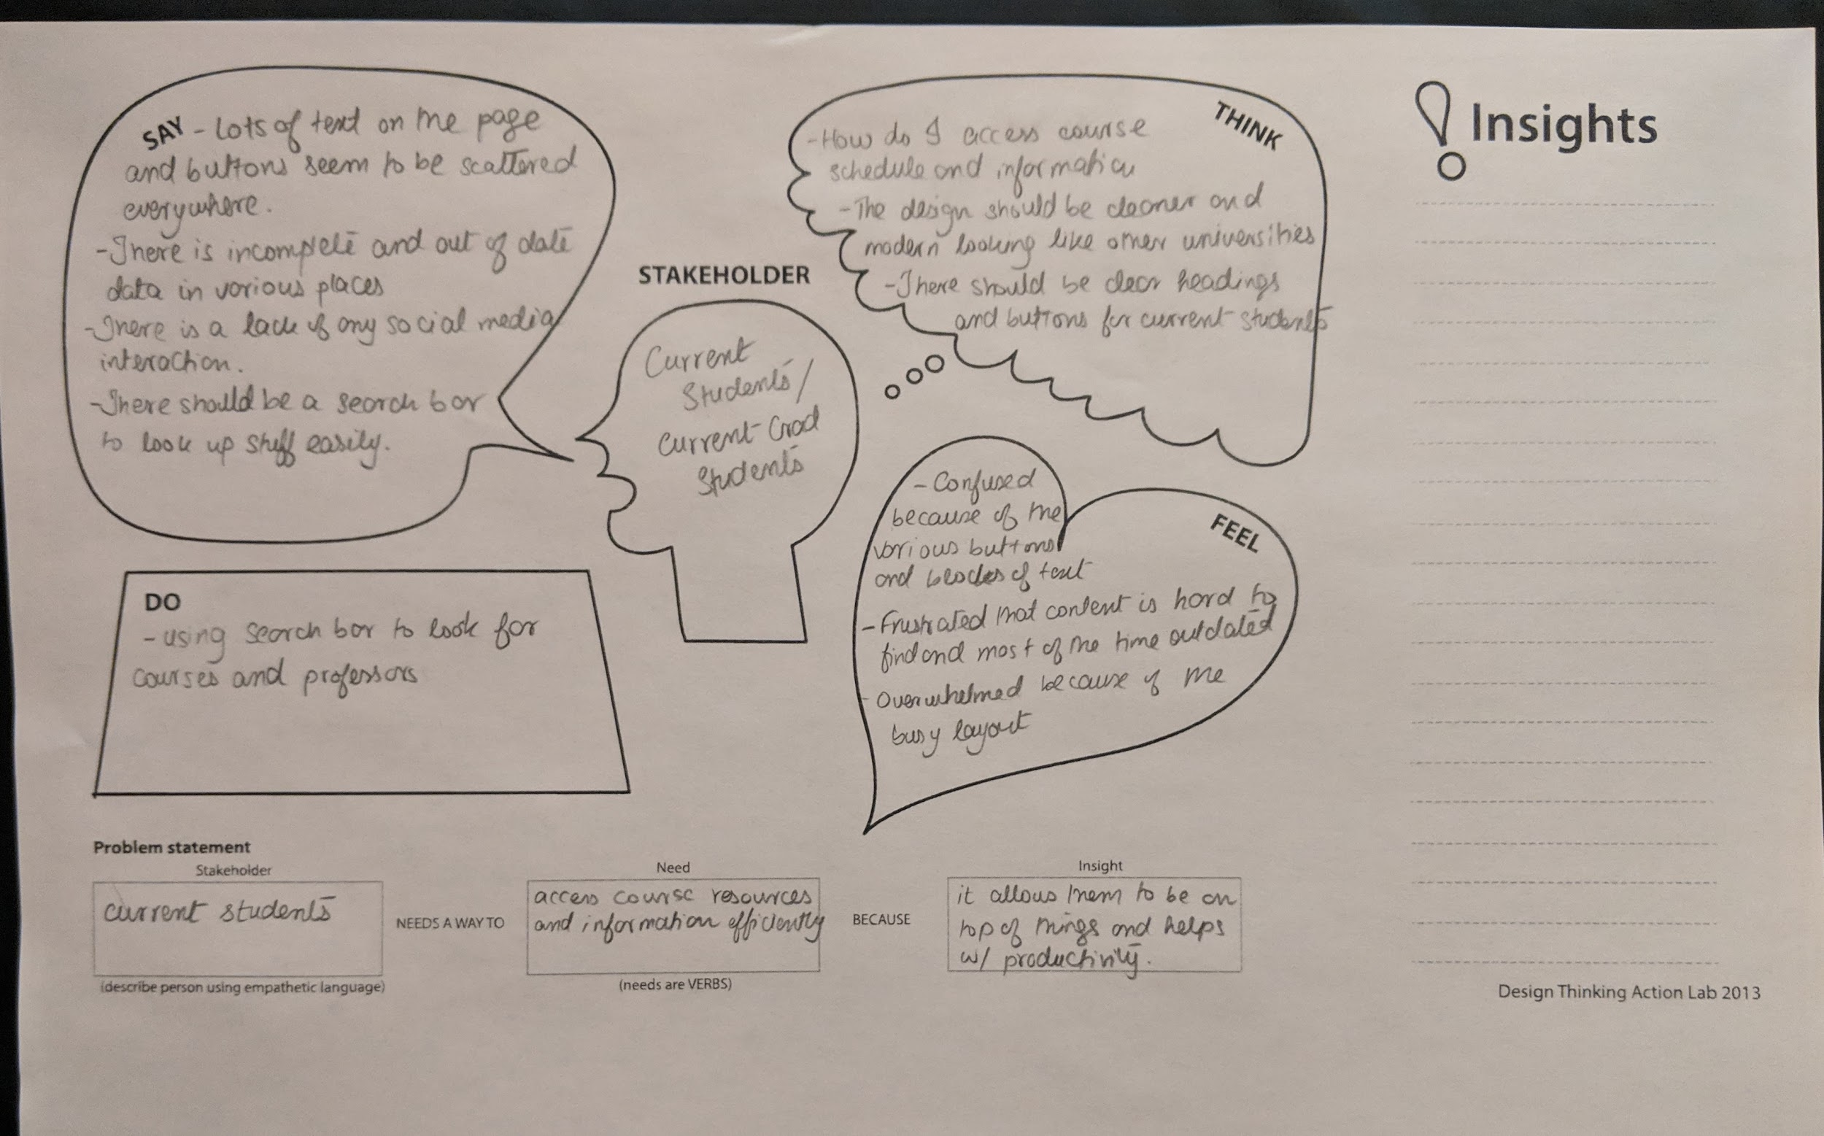
Empathy Maps
Current Students - Shayan

Slide 6
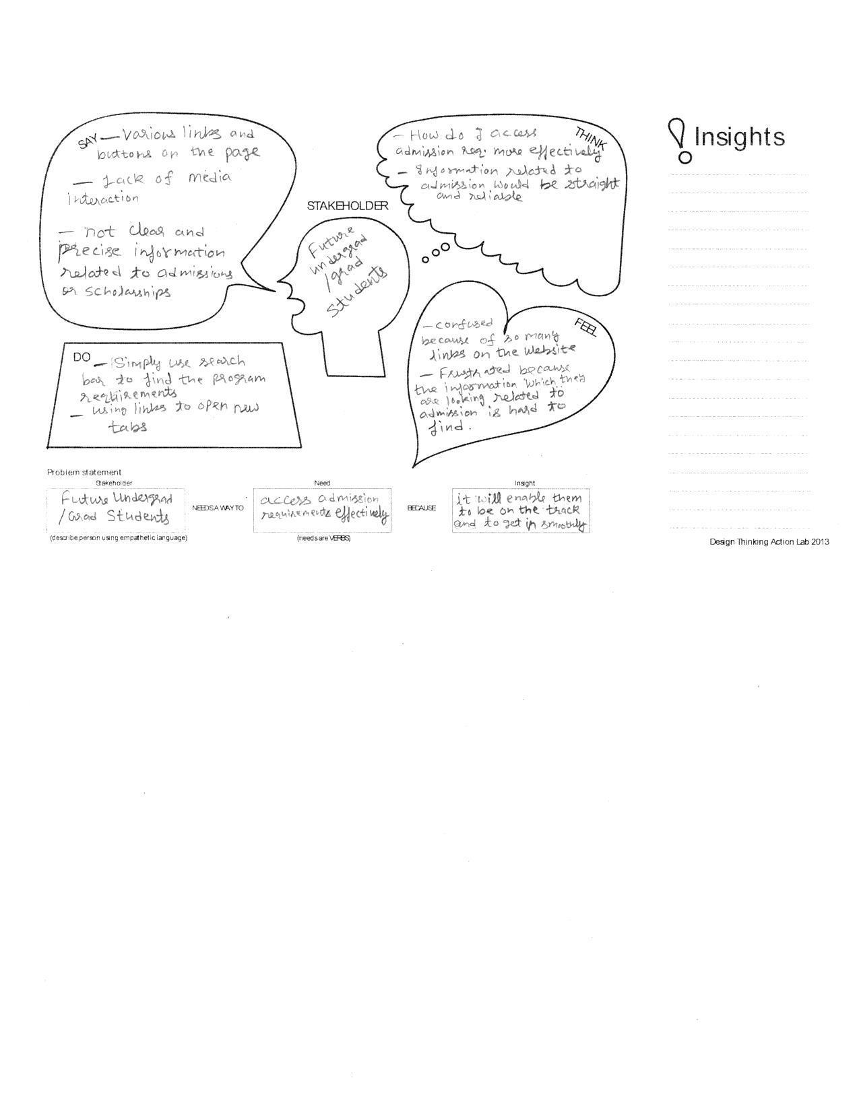
Empathy Maps
Future Students - Ali

Slide 7
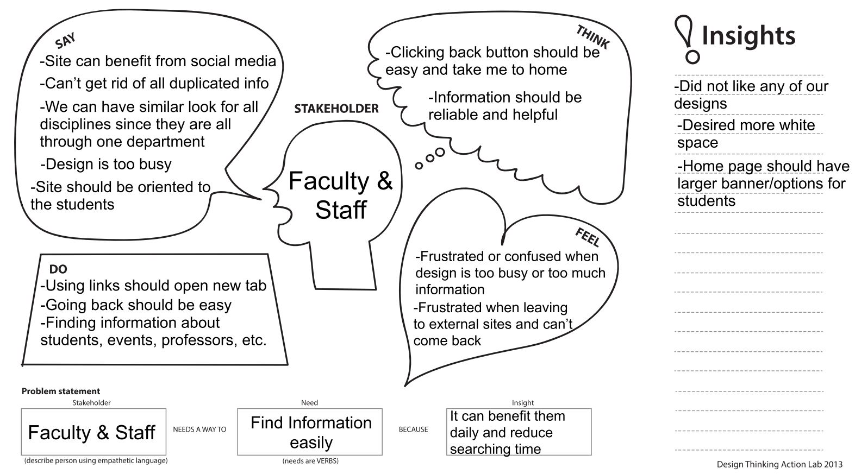
Empathy Maps
Faculty and Staff - Evan

Slide 8
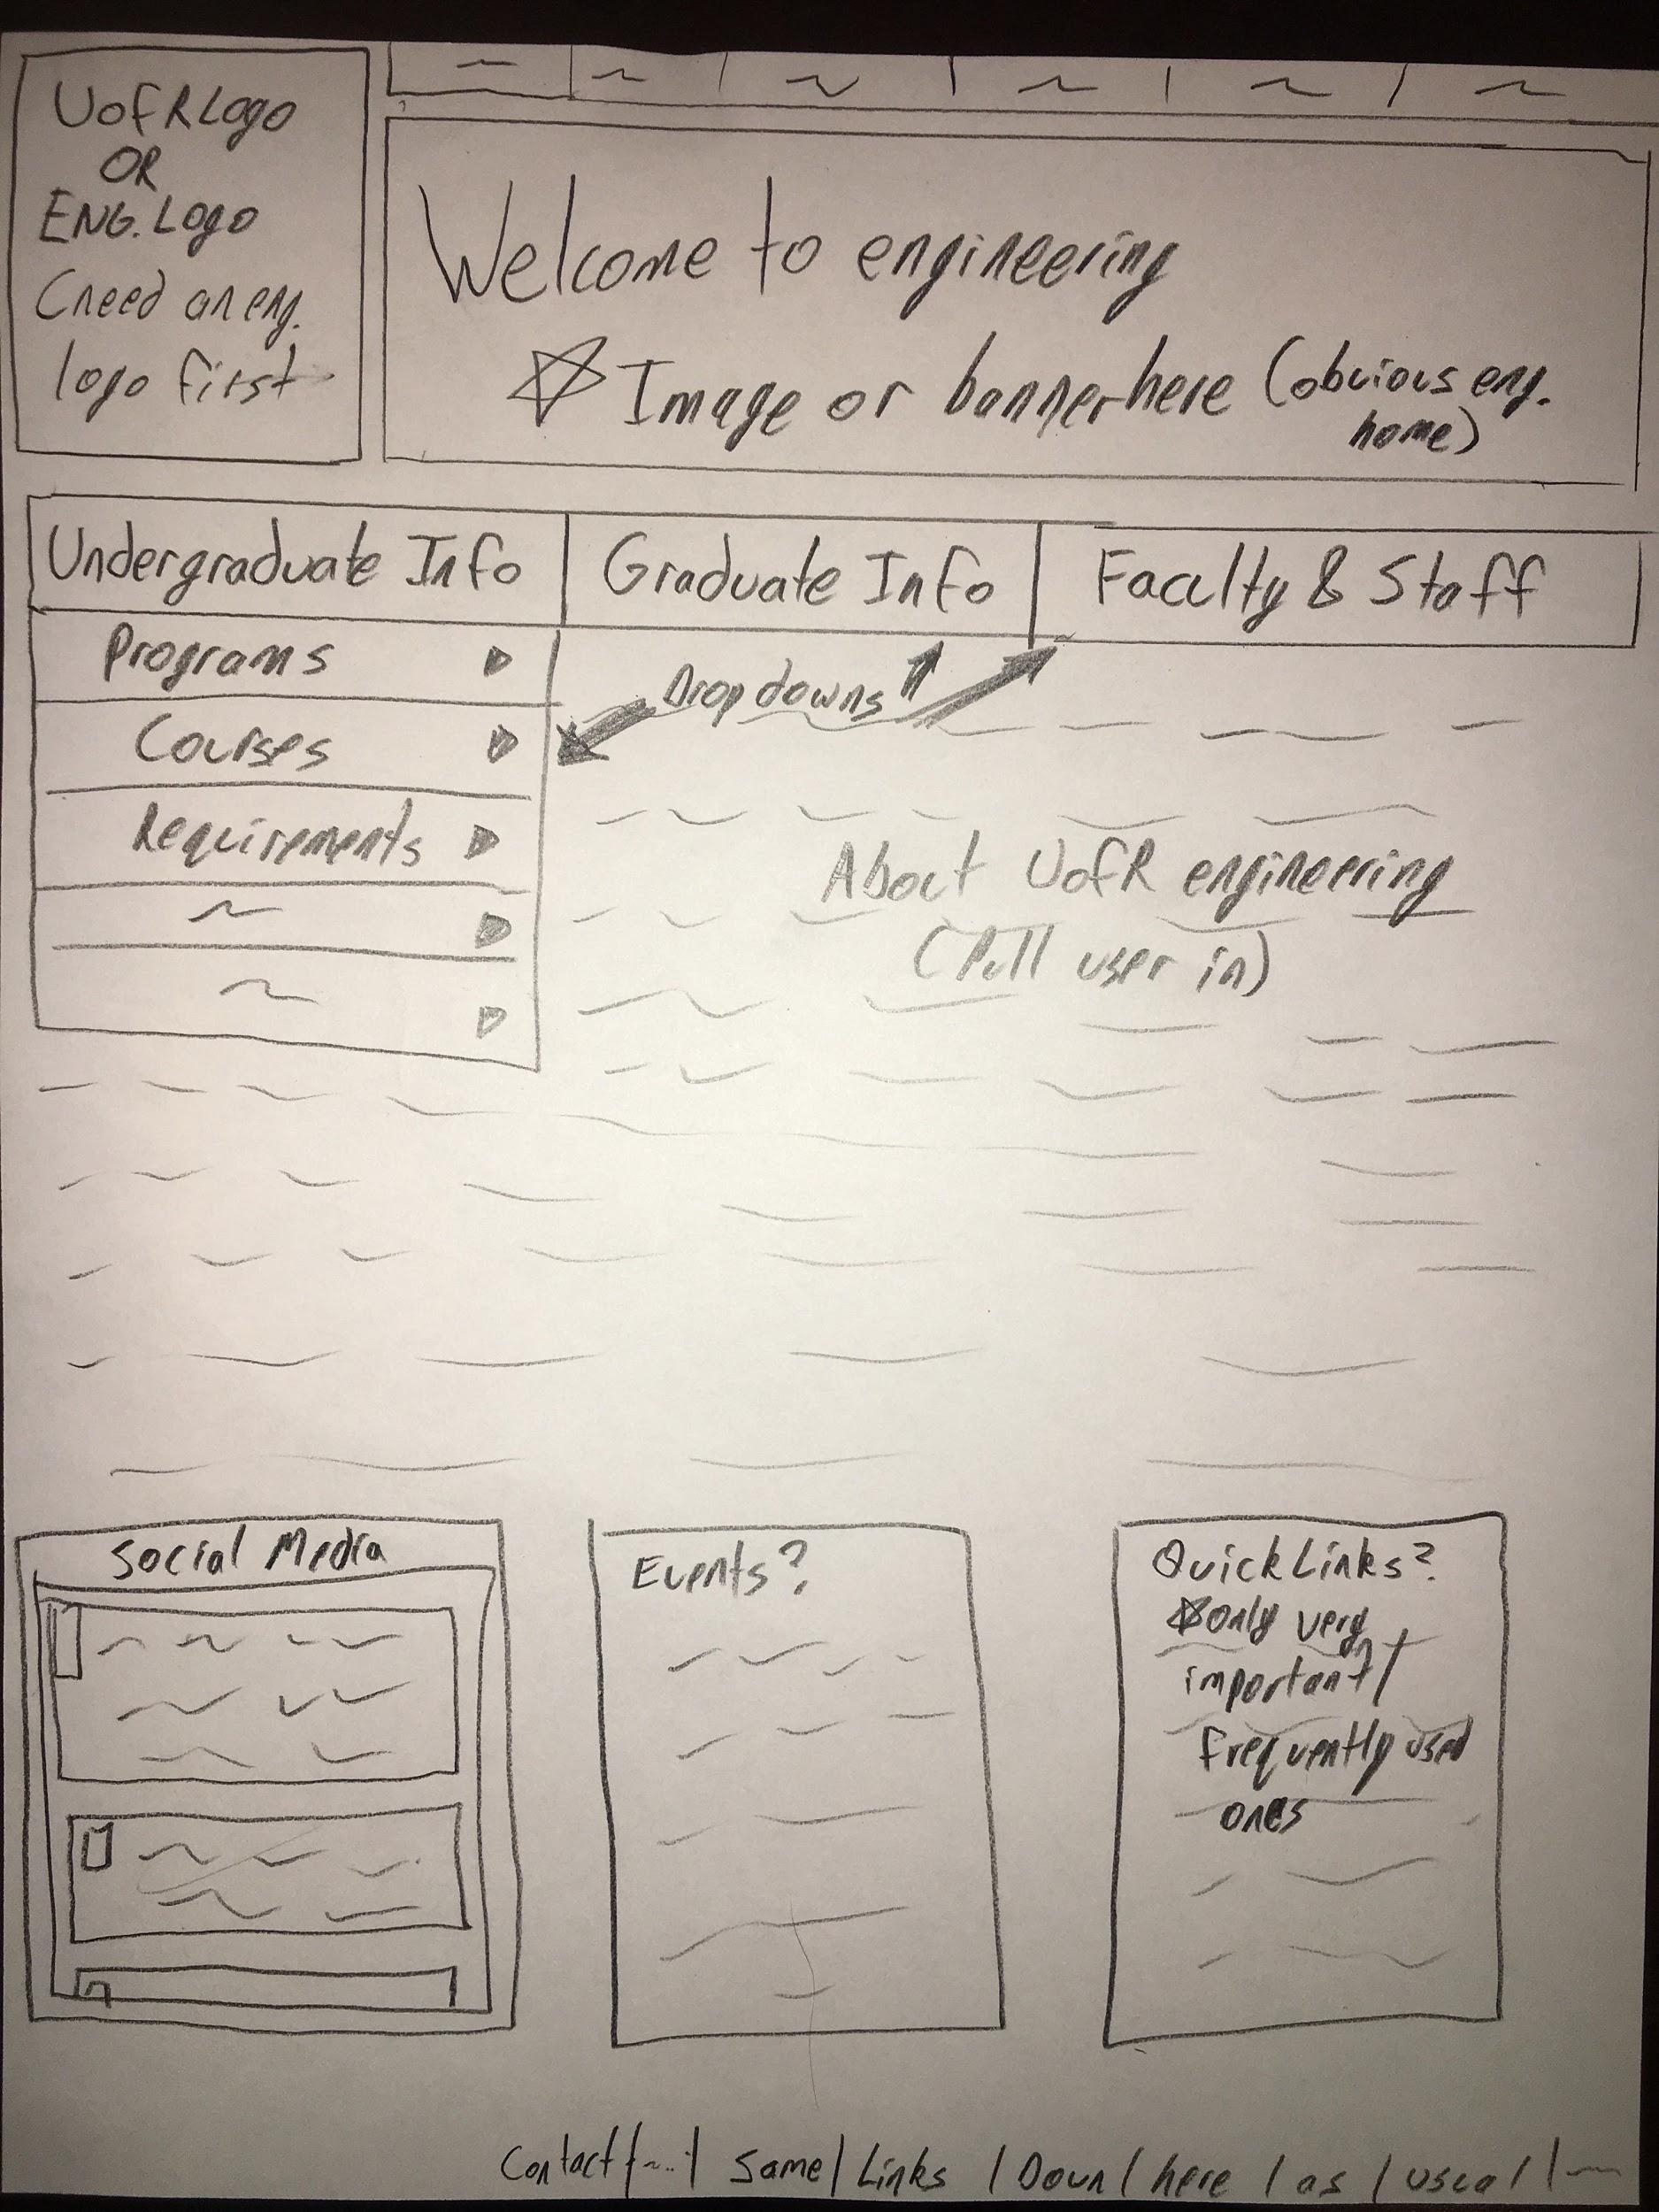
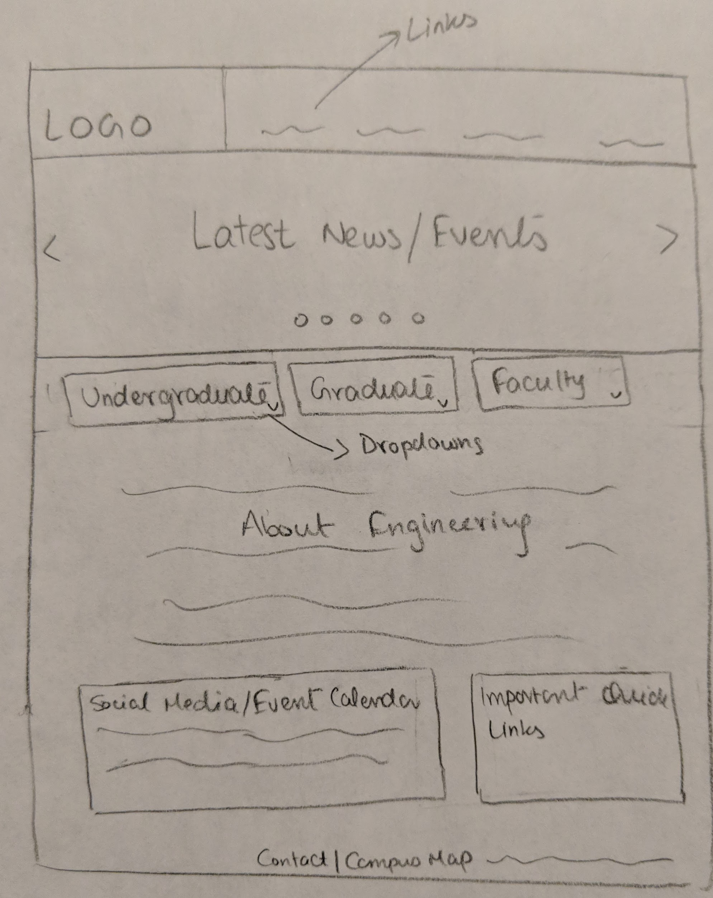
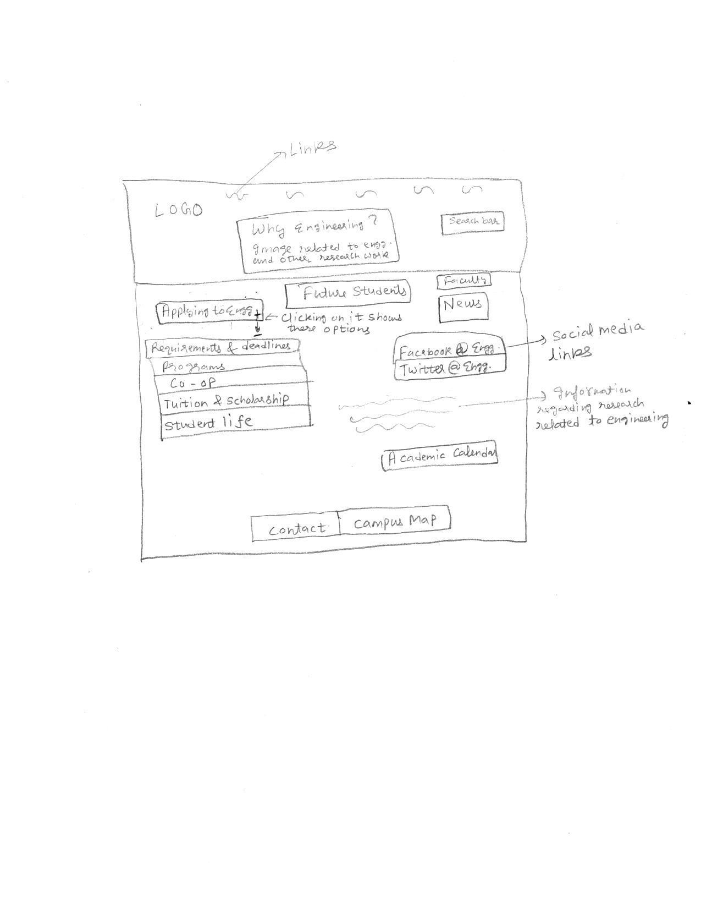
Brainstorm #2

Slide 9
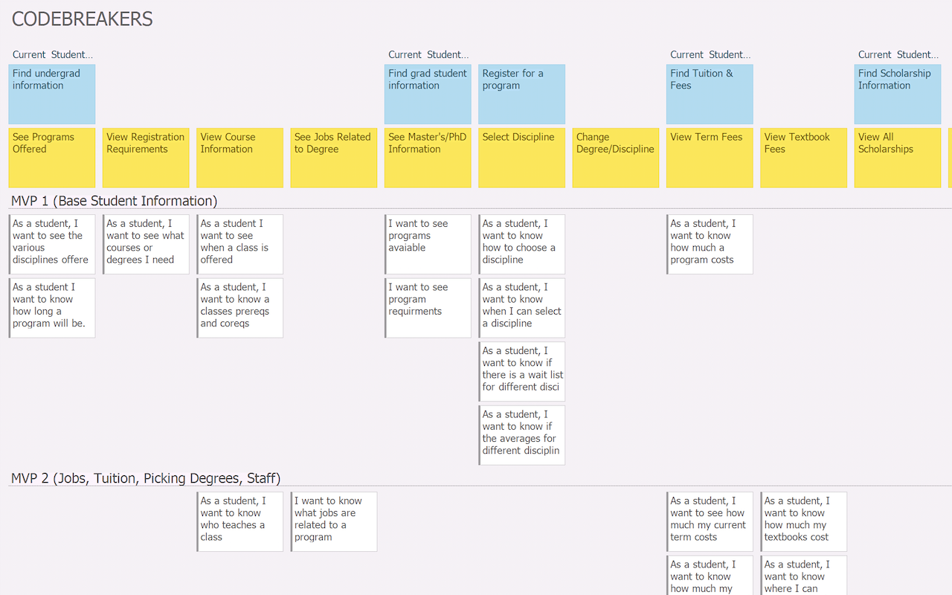
USM Updated

Slide 10
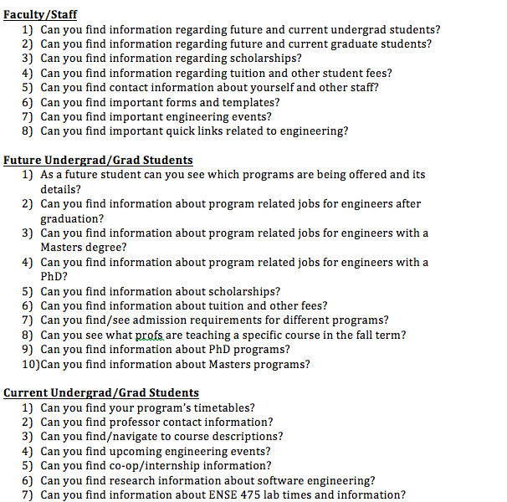
Usability Questions

Slide 11
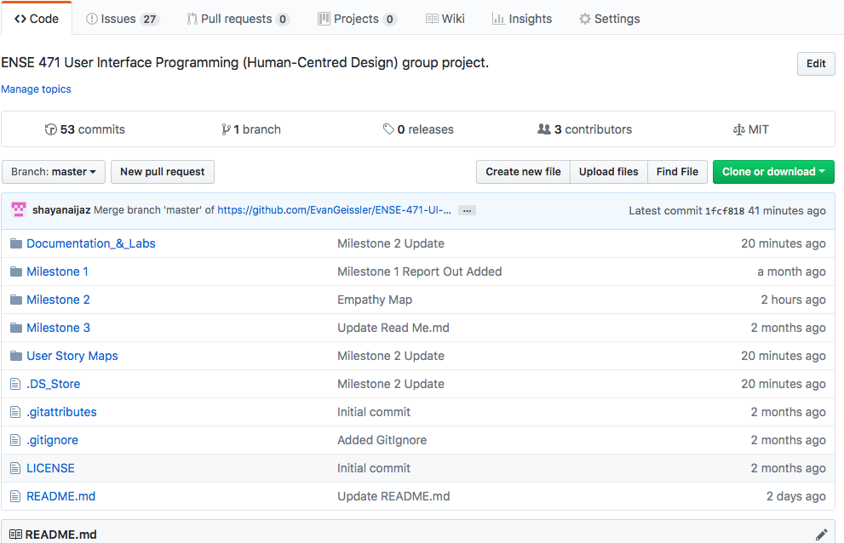
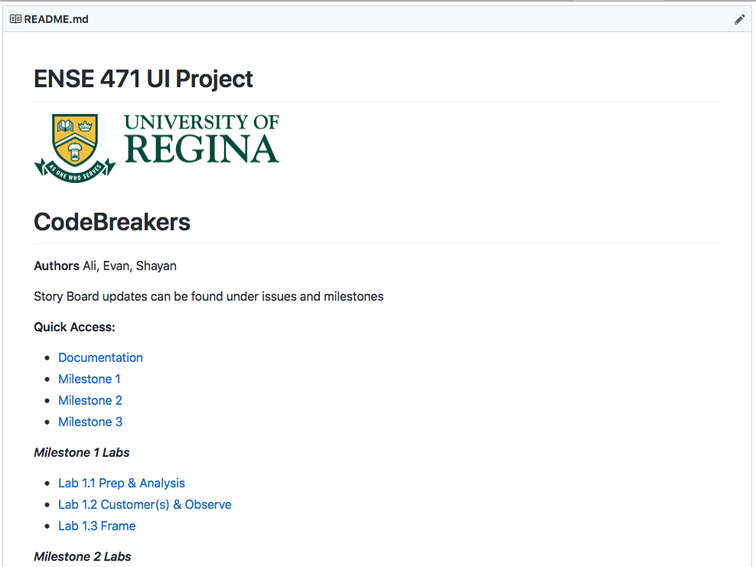
GitHub: Main Page & Read Me

Slide 12
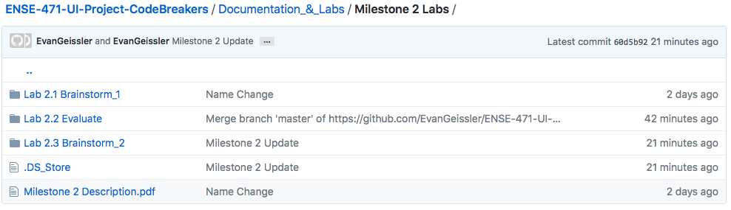
GitHub: Milestone 2 Documentation

Slide 13
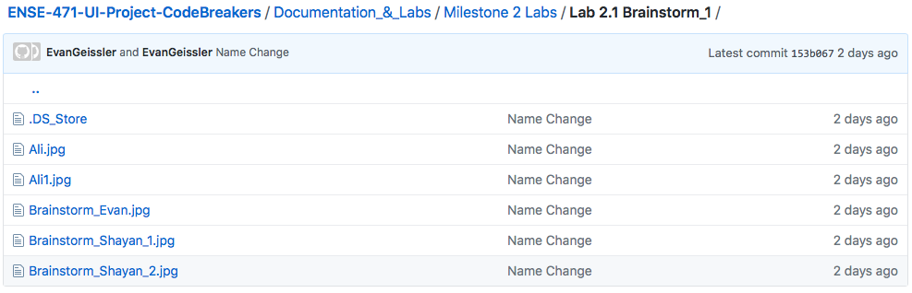
GitHub: Lab 2.1

Slide 14
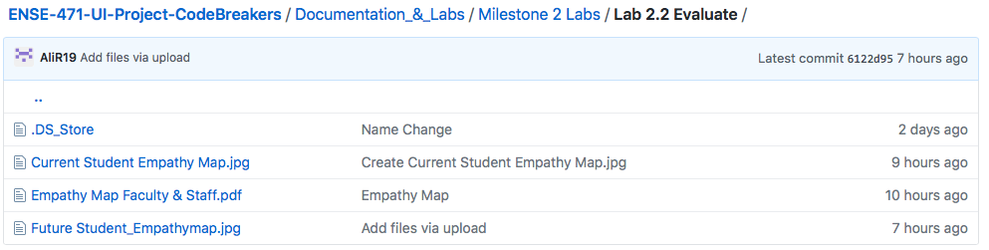
GitHub: Lab 2.2

Slide 15
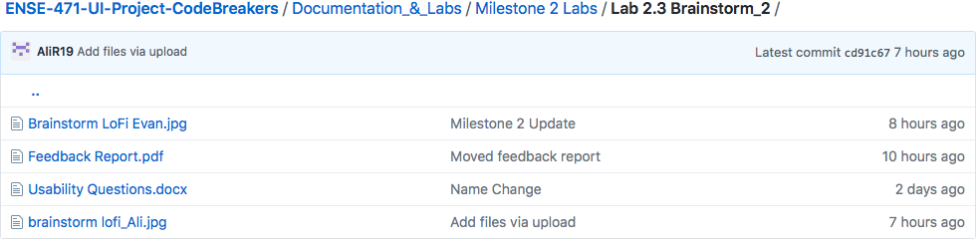
GitHub: Lab 2.3

Slide 16
Group Reflection
How did you feel about this milestone? What did you like about it? What did you dislike?
Liked using paper graphics to directly display our ideas
We realize there is still room to improve, however we are getting close to it
What did you learn about yourself as you collaborated and worked through this milestone?
Brainstorming ideas from everyone helps a lot
Planning and brainstorming ideas before starting the work so that the overall changes can be minimized later on

Slide 17
Group Reflection
What “stuff & things” related to this milestone would you want help with?
A bit more time to do the research and planning
How will you use what you have learned going forward?
To balance the expected needs from different users
Plan things out before actually executing the ideas behind them.Changes becomes more costly as the project progresses

Slide 18
Questions?

